Slide 1

B.Tech
BCSE497J - Project-I
Deep Learning-Based Urinary Bladder Volume Quantification from Transabdominal Ultrasound with Intelligent Segmentation and Self-Calibration
Team members:
Nidhi Anand Karva (23BDS0031)
Aditya Atul Deshmukh (23BAI0072)
Faculty guide : Dr. Devipriya A

Slide 2
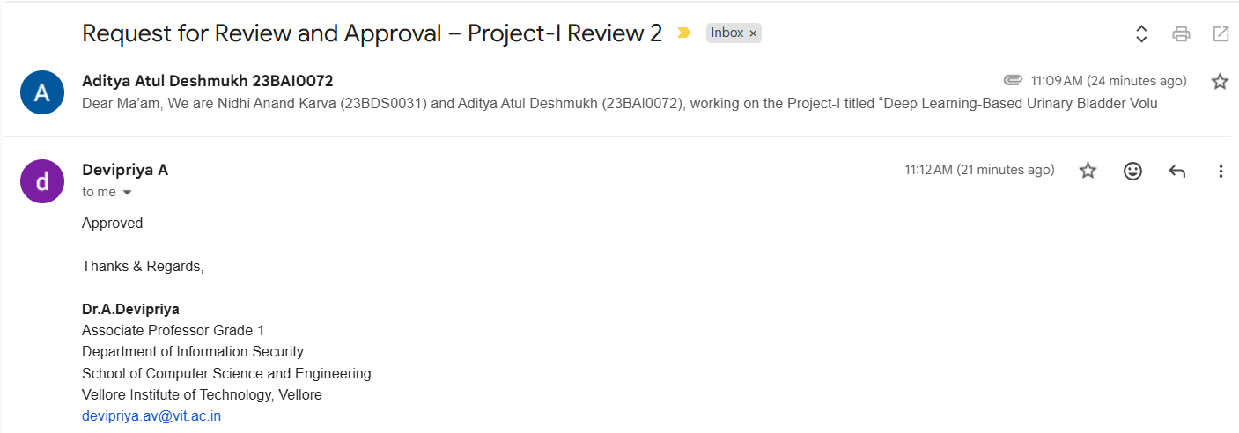
Approval Mail From Guide

Slide 3
Aim
To automate urinary bladder volume estimation from ultrasound images, removing the need for manual caliper placement
To segment the bladder and extract the three diameters required for volumetric calculation, with automatic pixel-to-millimetre calibration
To compute bladder volume using the validated ellipsoid formula (Volume = 0.52 × d1 × d2 × d3)
To ensure clinical reliability through visual verification at each stage and robustness to real-world image variations

Slide 4
Abstract
Bladder volume from ultrasound is usually measured by hand across six points — slow, operator-dependent, and inconsistent.
This project estimates bladder volume automatically, straight from the image.
It separates the two views, finds the bladder in each, and traces its outline.
It extracts the three diameters and computes volume using the ellipsoid formula.
Real-world scale is read automatically from the image's depth markings — no manual calibration.
Goal: faster, more consistent, operator-independent bladder volume estimation.

Slide 5


Literature Review
Paper | Objective | Methodology | Pros / Cons | Findings
Fully Automated Segmentation | Automate bladder sac segmentation and DWT measurement. | 2D U-Net CNN + Multi-dimensional Dynamic Programming (MDP). | Pros: Very fast (<1 s). Cons: Small training dataset (11 subjects). | Automated DWT error of 0.7 ± 0.2 mm compared to experts.
Revolutionizing Bladder Health | Evaluate AI-based 2D bladder volume measurement accuracy. | AI module (LVivo) using the prolate ellipsoid formula. | Pros: Perfect reproducibility. Cons: Single-center study. | Pearson correlation of r = 0.97 for volume measurement.
Bladder Weight Estimation | Develop automated UEBW measurement as an obstruction indicator. | Weight = (Surface Area × Thickness) × 0.957 gravity constant. | Pros: Eliminates spherical assumption. Cons: Primarily designed for 3D data. | Healthy male UEBW averages 42 ± 6 g.
Noninvasive BOO Evaluation | Review all noninvasive methods for bladder outlet obstruction detection. | Review of PVR, PSA, IPP, BWT, and Near-Infrared Spectroscopy. | Pros: Covers multiple noninvasive diagnostic methods. Cons: Variations in diagnostic accuracy. | Grade III IPP shows 92% specificity for diagnosing bladder outlet obstruction.
Non-invasive Ultrasound Review | Systematically review BWT/DWT and UEBW for diagnosis. | PRISMA guidelines; PubMed search (1995–2016). | Pros: Comprehensive review. Cons: Lack of international standardization. | DWT identified as the best predictor for obstruction (AUC = 0.93).
Sonographic Reference Values | Establish healthy population norms for BWT, DWT, and bladder weight. | Cross-sectional study of 384 healthy adults. | Pros: Non-invasive. Cons: Manual measurement variability. | Mean healthy BWT = 2.8 ± 0.3 mm, DWT = 1.3 ± 0.1 mm.

Slide 6
Research Gap
Existing methods rely on expert-acquired ultrasound images and vendor-specific calibration, limiting use across different ultrasound devices.
Manual bladder measurements suffer from high inter-observer variability (0%–24.7%), reducing measurement consistency.
Current automated systems are sensitive to noise, blur, artifacts, and low bladder filling volumes, affecting segmentation accuracy.
Most studies use either traditional image processing or deep learning alone, with limited hybrid segmentation approaches.
Existing frameworks focus on a single clinical parameter (e.g., bladder volume or wall thickness) rather than providing a comprehensive assessment.
Many AI-based solutions act as black-box models with limited explainability, reducing clinician confidence and trust.

Slide 7


Objectives
Develop a hybrid bladder segmentation framework using Chan-Vese Active Contours and DenseNet-121.
Implement automated spatial self-calibration for accurate ultrasound measurements.
Estimate urinary bladder volume using automated segmentation and the prolate ellipsoid formula.
Improve robustness against noise, blur, and ultrasound artifacts.
Enable real-time, non-invasive bladder volume estimation.
Reduce manual measurement variability through an automated clinical decision-support system.
Identified: SDG 3 – Good Health and Well-being | TRL 4 – Technology Validated in Lab | Outcomes: Journal

Slide 8
Framework/Architecture/Block Diagram
Input: dual-panel transabdominal ultrasound image (ROI).
Stage 1 - Panel split + spatial self-calibration by detecting depth-scale ruler ticks (pixel to mm).
Stage 2 - Bladder localisation: DenseNet-121 (deep learning) and Chan-Vese active contour (classical) segment each panel.
Stage 3 - Boundary refinement: ellipse fit bounded inside the detected region, refined by Chan-Vese.
Stage 4 - Extract three diameters (d1 horizontal, d2 vertical, d3 diagonal) and compute Volume = 0.52 x d1 x d2 x d3.
Output: bladder volume (ml) with per-stage visual verification.

Slide 9
Functional Requirements
Accept a cropped dual-panel ultrasound ROI image as input.
Automatically split left/right panels and calibrate pixel-to-mm scale from on-image depth ticks.
Segment the bladder region using classical (Chan-Vese) and deep-learning (DenseNet-121) methods.
Extract the three orthogonal diameters and compute bladder volume via the ellipsoid formula.
Visualise each processing stage for clinical verification.
Operate without vendor-specific calibration or manual caliper placement.

Slide 10
Modules
1. Pre-processing & ROI handling - load image, split dual panels, exclude background.
2. Self-calibration - detect depth-scale ruler ticks to derive mm-per-pixel automatically.
3. Classical segmentation - threshold region-growing + ellipse fit + Chan-Vese refinement.
4. Deep-learning segmentation - DenseNet-121 U-Net trained on pipeline-generated masks.
5. Measurement - horizontal, vertical and diagonal diameter extraction.
6. Volume estimation & comparison - ellipsoid volume; classical vs deep-learning vs reference.

Slide 11
Experiments and Results
Validated on transabdominal ultrasound scans with on-screen reference measurements.
On images with reliable ground truth, classical pipeline volume error ~3-12%; deep-learning ~0.6-7%.
Deep-learning segmentation runs ~15-130x faster per image than the classical Chan-Vese method.
Self-calibration from depth-scale ticks matched reference scale to within ~0.2-0.4%.
Note: current results are preliminary on a small dataset (~50 images) and to be extended with a larger held-out test set.

Slide 12
Conclusion
An automated, non-invasive bladder volume estimation pipeline was developed from 2D transabdominal ultrasound.
It removes manual caliper placement and self-calibrates without vendor-specific settings.
A hybrid of classical (Chan-Vese) and deep-learning (DenseNet-121) segmentation was compared: the classical method is the accurate reference, while the deep-learning model replicates it at much higher speed.
Future work: larger annotated dataset, hybrid learned-initialisation + classical-refinement, and extension to additional bladder biomarkers.

Slide 13
References
[1] Z. Akkus, B. H. Kim, R. Nayak, A. Gregory, A. Alizad, and M. Fatemi, "Fully automated segmentation of bladder sac and measurement of detrusor wall thickness from transabdominal ultrasound images," 2020.
[2] E. A. Alpert, D. D. Gold, D. Kobliner-Friedman, M. Wagner, and Z. Dadon, "Revolutionizing bladder health: Artificial-intelligence-powered automatic measurement of bladder volume using two-dimensional ultrasound," Diagnostics, vol. 14, no. 16, Art. no. 1829, Aug. 2024.
[3] V. Chalana, S. Dudycha, J.-T. Yuk, and G. McMorrow, "Automatic measurement of ultrasound-estimated bladder weight from three-dimensional ultrasound," Reviews in Urology, vol. 7, Suppl. 6, pp. S22–S28, 2005.
[4] D. S. Elterman, B. Chughtai, R. Lee, A. E. Te, and S. A. Kaplan, "Noninvasive methods to evaluate bladder outlet obstruction in men," International Brazilian Journal of Urology, vol. 39, no. 1, pp. 4–19, Jan.–Feb. 2013.
[5] F. Presicce, C. De Nunzio, M. Gacci, E. Finazzi Agrò, and A. Tubaro, "Non-invasive ultrasound measurements in male patients with lower urinary tract symptoms and benign prostatic obstruction: Implication for diagnosis and treatment," Minerva Urologica e Nefrologica, vol. 69, no. 3, pp. 220–233, Jun. 2017.
[6] A. C. Ugwu et al., "Sonographic reference values for bladder wall thickness, detrusor wall thickness and bladder weight in apparently healthy adults in a Nigerian population," Journal of Ultrasonography, 2018._x000B_

